Slide 1
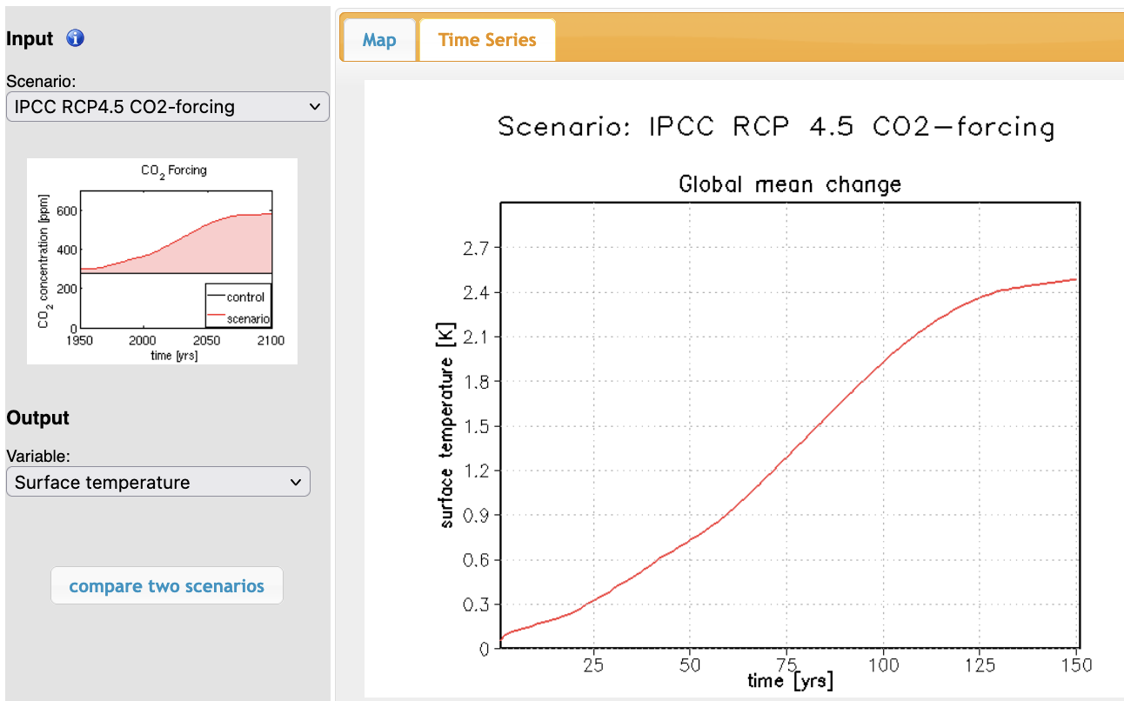
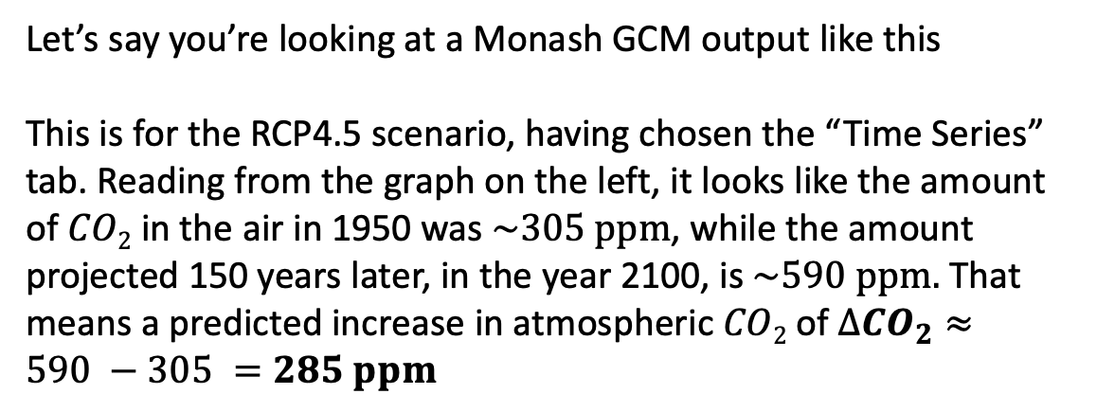
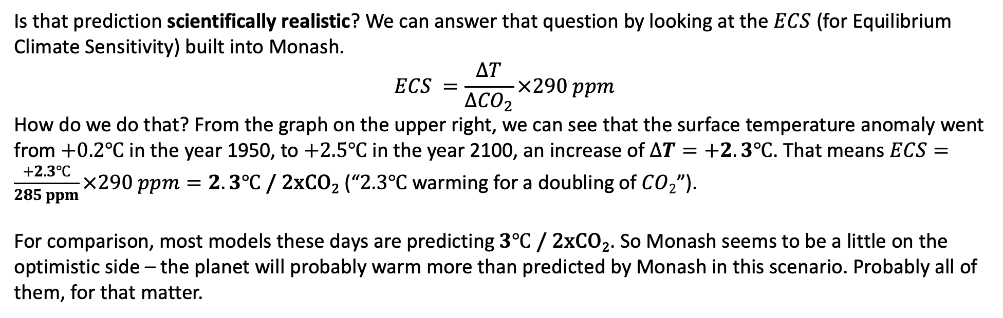
Getting an Equilibrium Climate Sensitivity from a Monash-derived GCM
Let’s say you’re looking at a Monash GCM output like this
This is for the RCP4.5 scenario, having chosen the “Time Series” tab. Reading from the graph on the left, it looks like the amount of $CO2$ in the air in 1950 was $\sim 305 ppm$, while the amount projected 150 years later, in the year 2100, is $\sim 590 ppm.$ That means a predicted increase in atmospheric $CO2$ of $∆{CO}_{2}≈590 −305 =285 ppm$
Is that prediction scientifically realistic? We can answer that question by looking at the $ECS$ (for Equilibrium Climate Sensitivity) built into Monash.
$$ECS =\frac{∆T}{∆{CO}_{2}}×290 ppm$$
How do we do that? From the graph on the upper right, we can see that the surface temperature anomaly went from $+0.2℃$ in the year 1950, to $+2.5℃$ in the year 2100, an increase of $∆T=+2.3℃$. That means $ECS=\frac{+2.3℃}{285 ppm}×290 ppm=2.3℃$ / 2xCO₂ (“$2.3℃$ warming for a doubling of $CO2$”).
For comparison, most models these days are predicting $3℃$ / 2xCO₂. So Monash seems to be a little on the optimistic side – the planet will probably warm more than predicted by Monash in this scenario. Probably all of them, for that matter.

